Slide 1



Machine Learning for Hackathons
model.fit()

Slide 2





Gagan Bhatia
Software Developer at AWS CIC
Lead Machine Learning Engineer at Omdena
Research Assistant at QCRI
President of Google Developer student Club at UBC
4th year ECE student at UBC

Slide 3
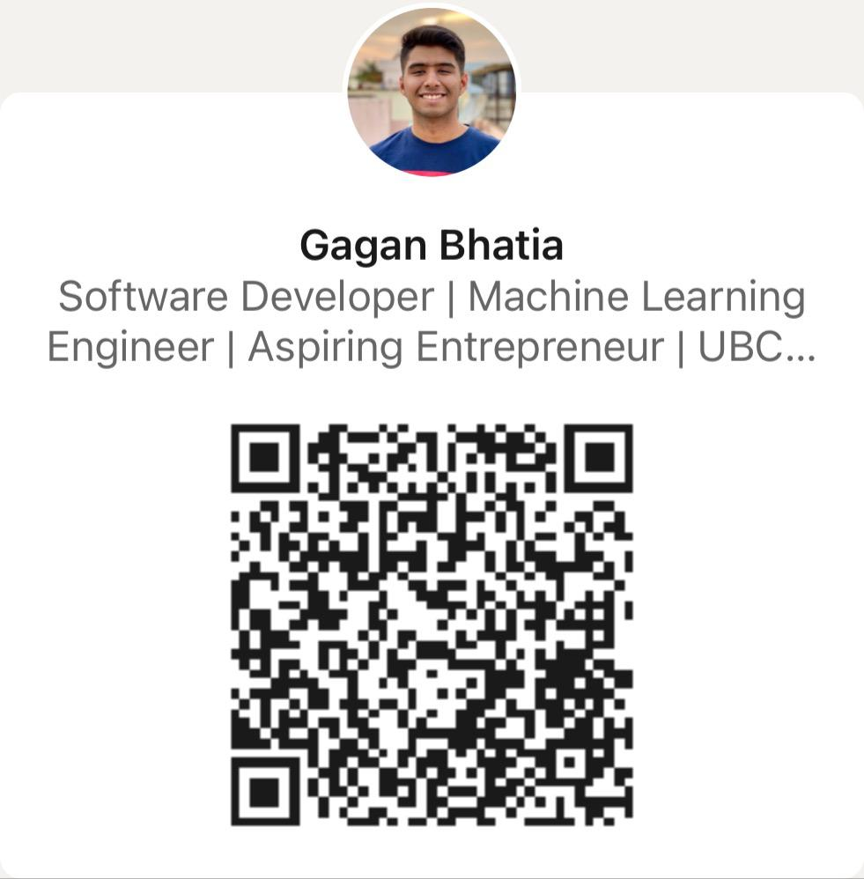
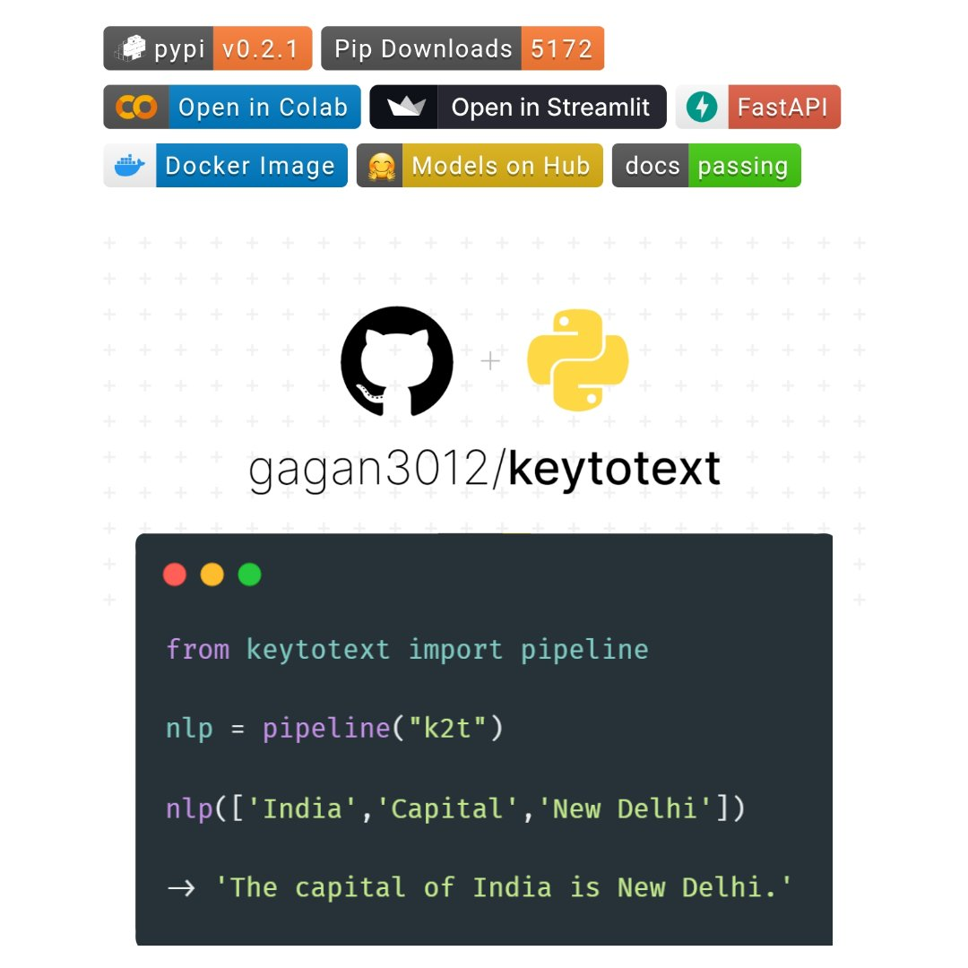
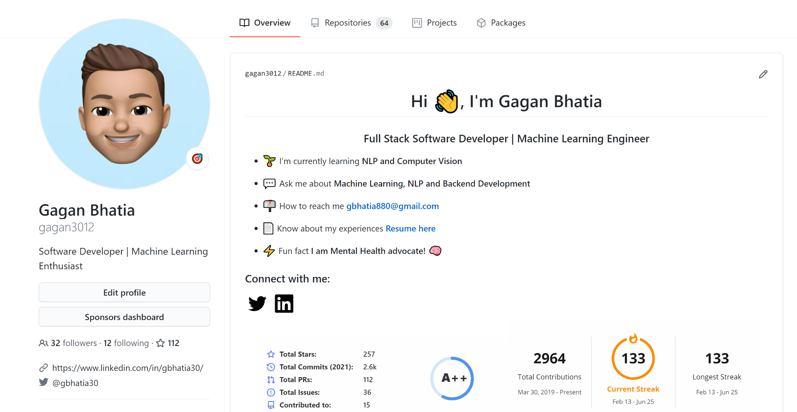
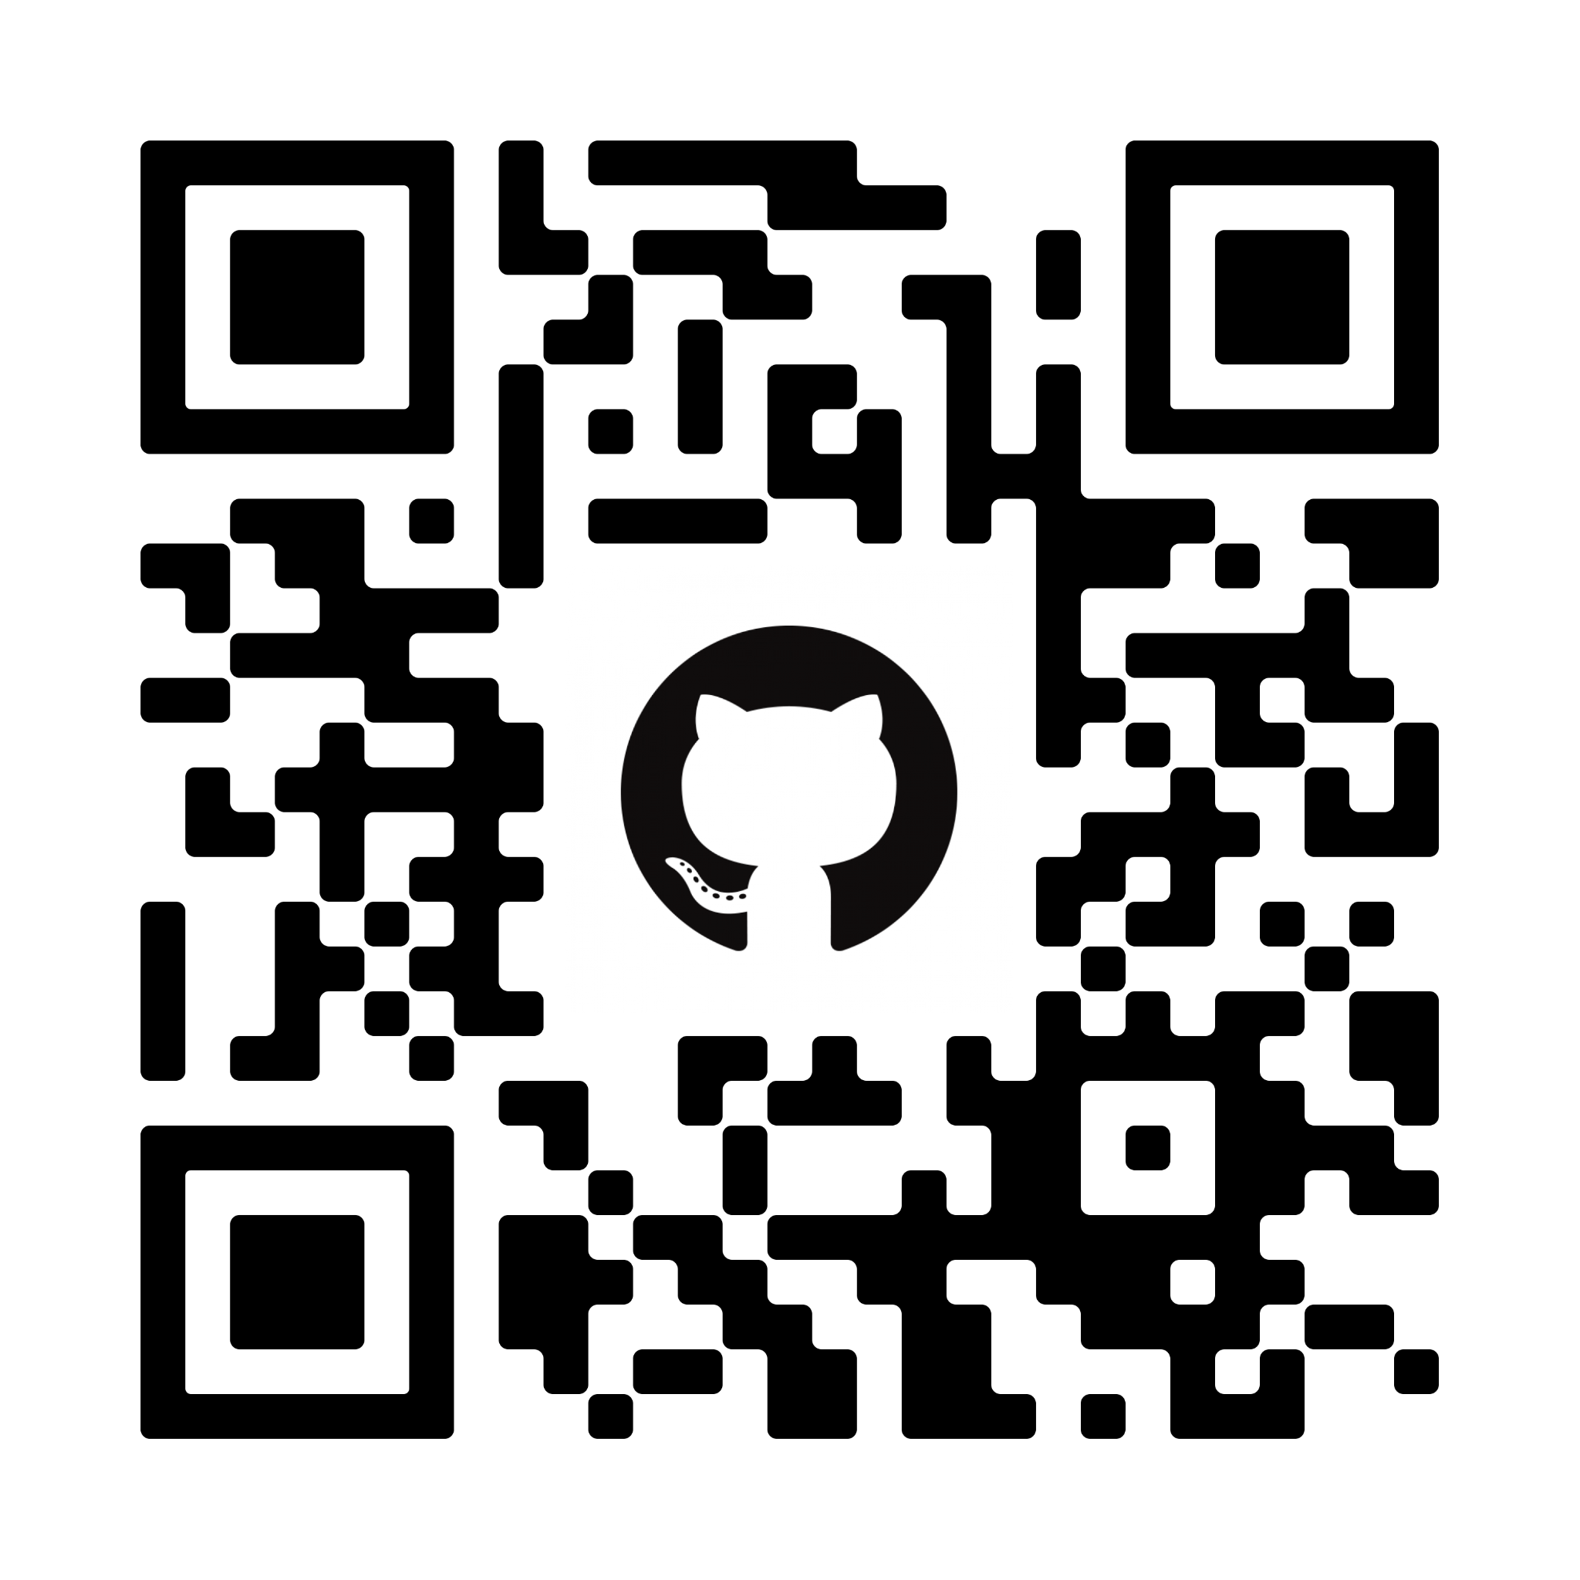
My Open Source Projects
GitHub: @gagan3012
Creator of Keytotext
Creator of Project-code-py
Paper implementations
Staysafe won the HealthHack 2021

Slide 4
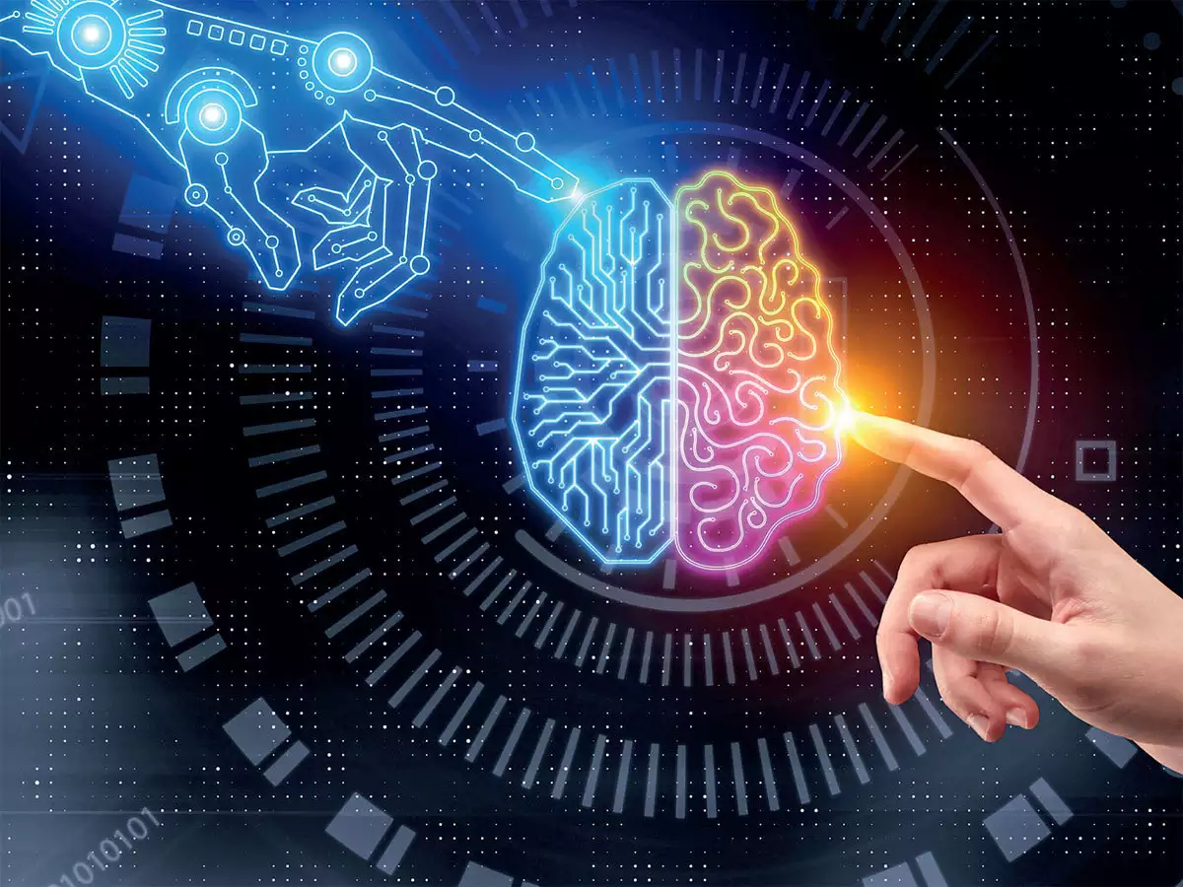
Contents
Today we’ll cover:
Introduction to concepts
Basics of ML and NLP
Playing around with Google Colab
Experimenting with Hugging Face Transformers
Deploying ML WebApps with Streamlit

Slide 5
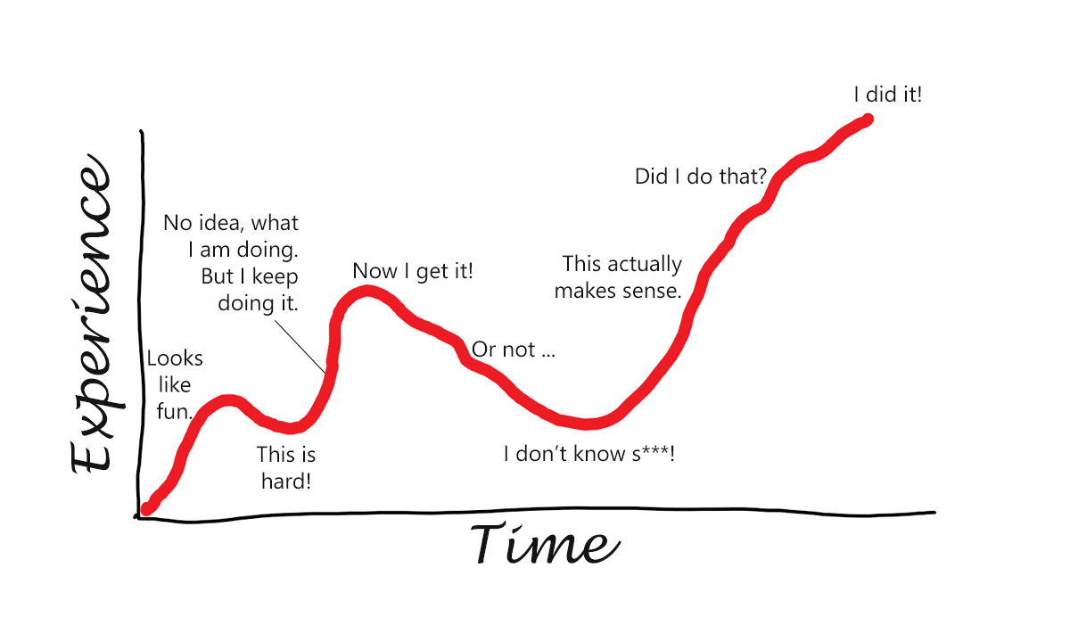
Prerequisites and Topics
Python Basics
Jupyter Notebooks basics
Topics
AI & Machine Learning
NLP - Natural Language Processing
ML Models - Training, Pre-training, Supervised, Etc.
Transformers

Slide 6
Machine Learning

Slide 7
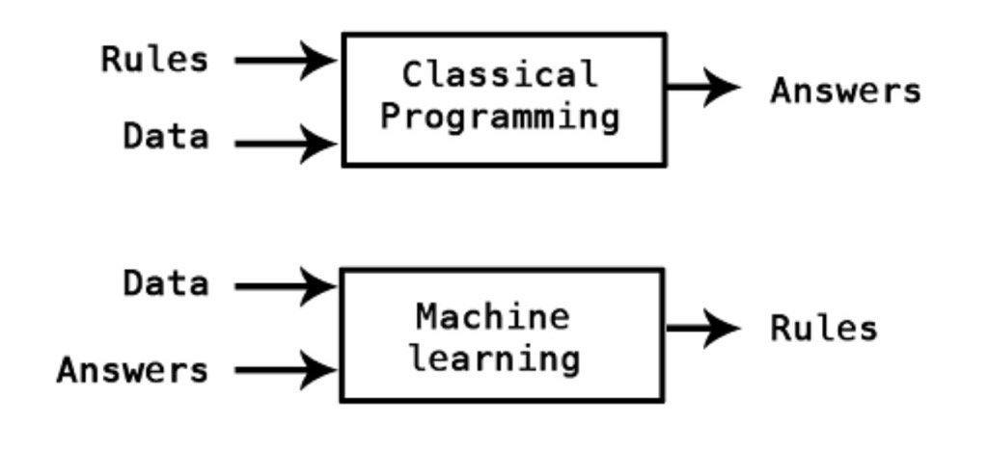
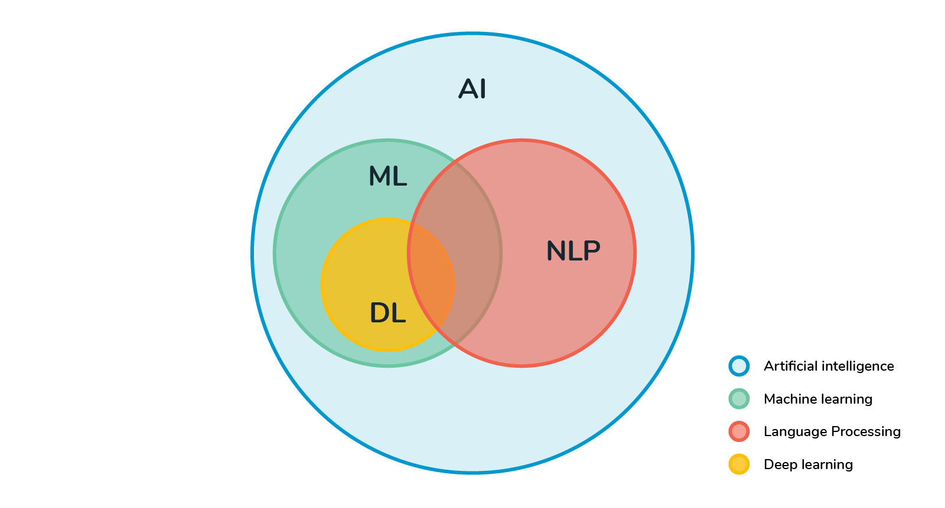
What is Machine Learning?
Machine learning is the study of computer algorithms that improve automatically through experience and by the use of data.

Slide 8

Why ML?
The heavily hyped, self-driving Tesla cars?
Online recommendation offers such as those from Amazon and Netflix?
Knowing what customers are saying about you on Twitter?
Fraud detection?

Slide 9
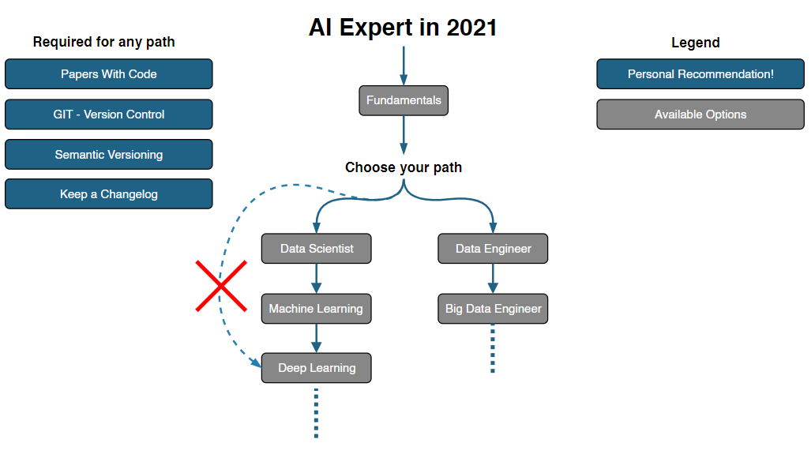
Understanding The Scope of AI & ML
Our workshop focuses on using “surface-level” tools to implement ML functions in your own projects.
The field of ML itself is just a subset of AI
While ML has been made accessible through different tools and open source projects, understanding how ML works is an extensive process.
https://i.am.ai/roadmap/

Slide 10

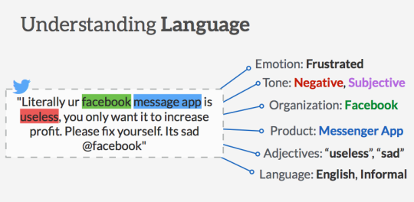
Natural language processing (NLP)
Machine learning (ML) for natural language processing (NLP) and text analytics involves using machine learning algorithms and “narrow” artificial intelligence to understand the meaning of text documents.
Computers tend to deal with structured data. They have a hard time with unstructured data: social media, news, emails, etc.

Slide 11
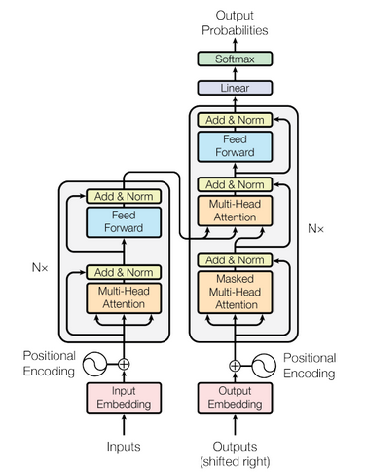
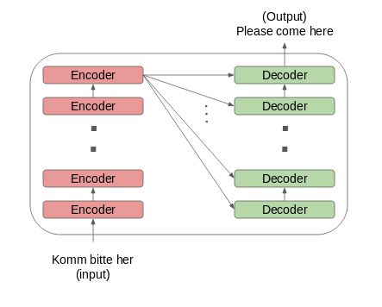
Transformers and Transfer Learning
The Transformer in NLP is a novel architecture that aims to solve sequence-to-sequence tasks while handling long-range dependencies with ease.

Slide 12
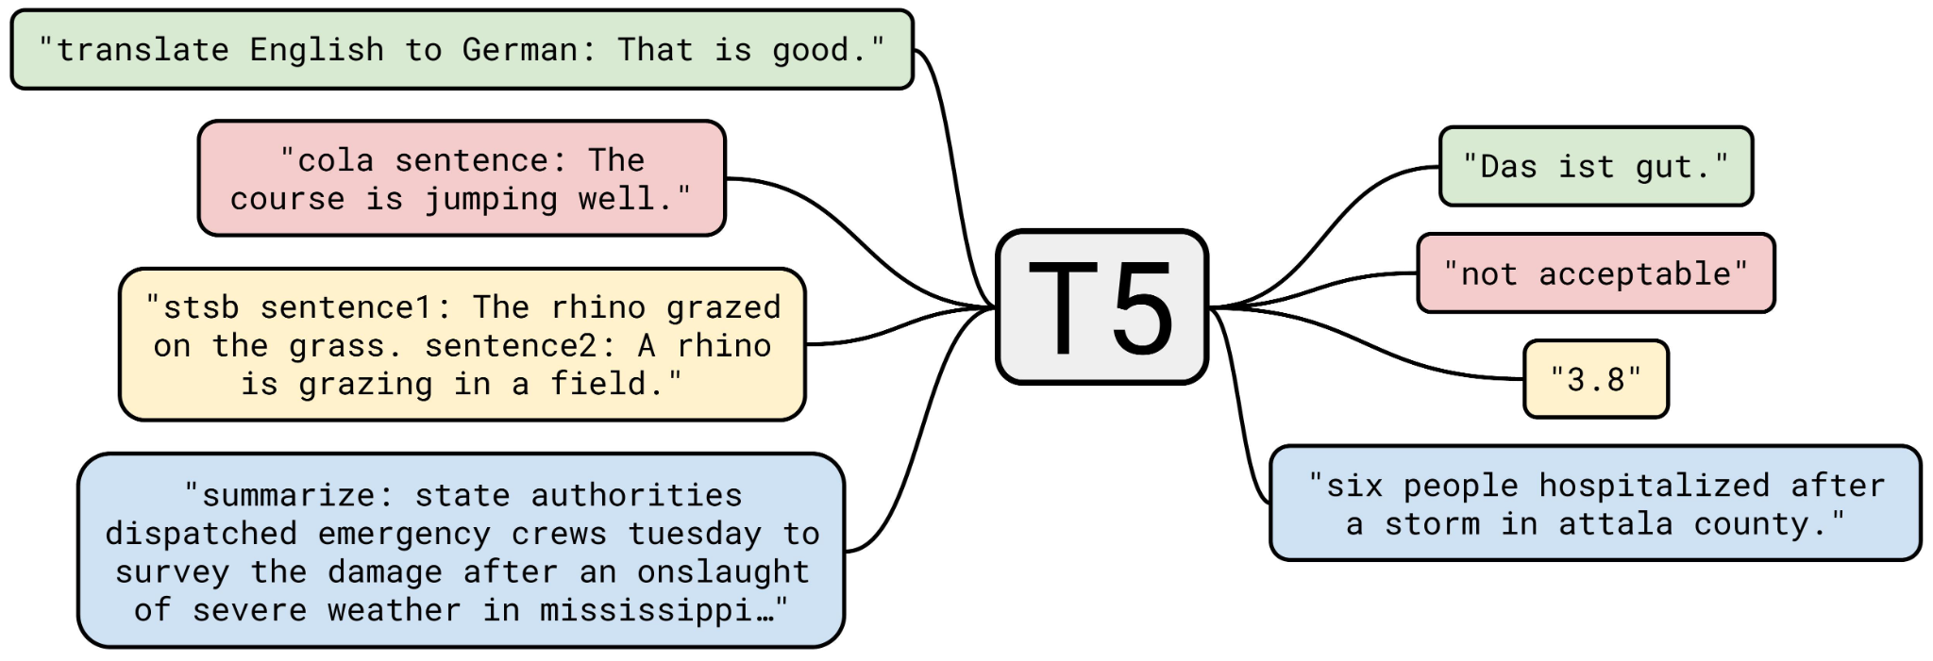
NLP Tasks
Sentiment Analysis
NER (Natural Entity Recognition)
Question Answering
Mask Fill
Text Generation
Summaration
Translation
Topic modeling

Slide 13





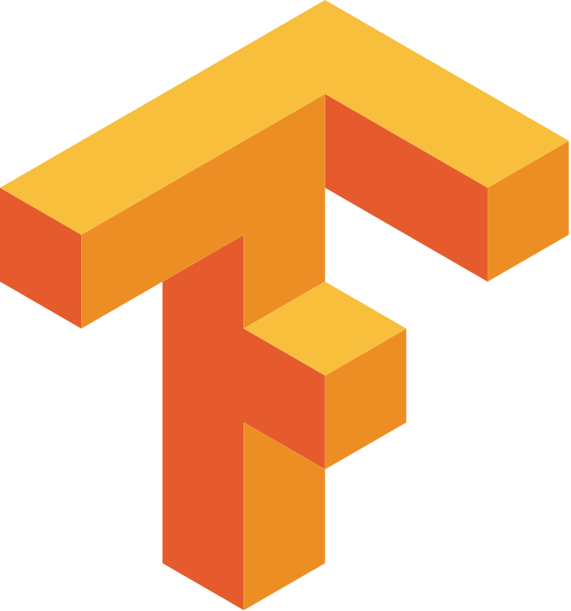
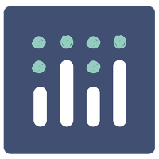
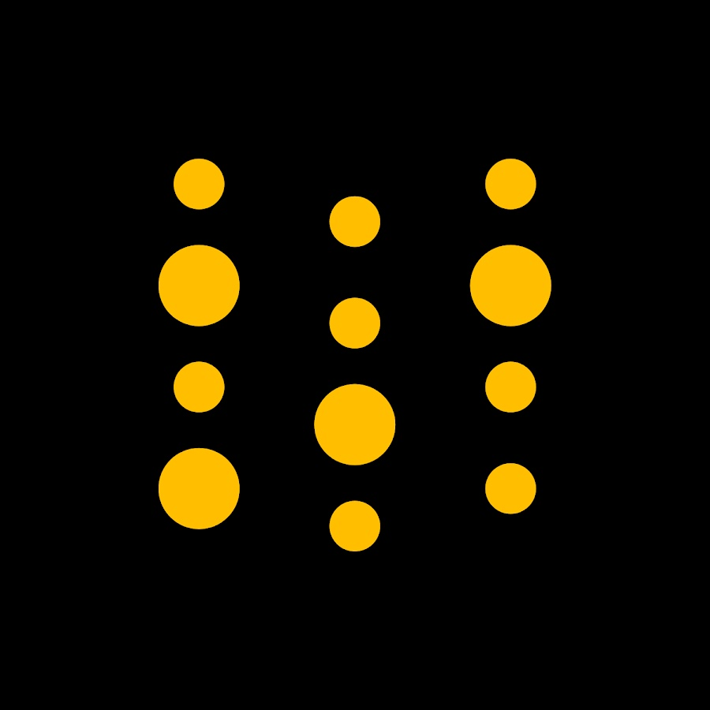
ML Tools and Libraries

Slide 14

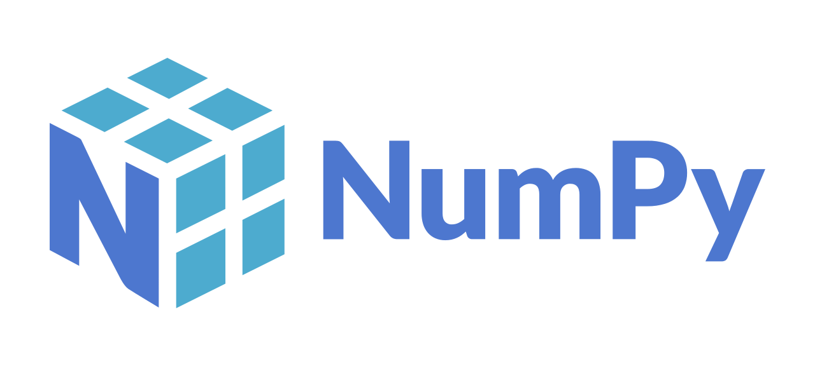

My ML Toolkit (Part 1)
Datasets:
Kaggle
🤗 Datasets
Tensorflow Hub
Data Preprocessing
Pandas
Numpy
Scipy
Data Visualisation
Matplotlib
Plotly
Altair

Slide 15

My ML Toolkit (Part 2)
ML Models
Pytorch
TensorFlow
Keras
ML Webapps
Streamlit
Gradio
NLP
🤗 Transformers
Notebooks
Google Colab
Kaggle Notebooks
Jupyter Notebooks

Slide 16
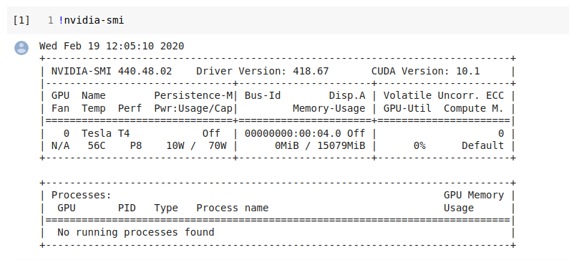
Google Colab
Pre-Installed Libraries - Pandas, NumPy, Matplotlib
Saved on the Cloud- Think Google Docs but for ML
Collaboration- Super Easy to Share Notebooks
Free GPU and TPU Use - Nvidia K80 / T4 12GB / 16GB

Slide 17
PyTorch
PyTorch is an open source machine learning library based on the Torch library,
Used for applications such as computer vision and natural language processing,
Developed by Facebook's AI Research lab.
Tensor computing (like NumPy) with strong acceleration via graphics processing units (GPU)
Deep neural networks built on a type-based automatic differentiation system
pip install torch

Slide 18
HuggingFace Transformers
Democratizing NLP, one commit at a time!
Hugging Face is an NLP-focused startup with a large open-source community, in particular around the Transformers library.
Transformers is based around the concept of pre-trained transformer models.
The advantage of using Transformers lies in the straight-forward model-agnostic API.
pip install transformers

Slide 19
Streamlit
The fastest way to build and share ML webapps
Streamlit is an open-source Python library that makes it easy to create and share beautiful, custom web apps for machine learning and data science
pip install streamlit
streamlit run app.py

Slide 20
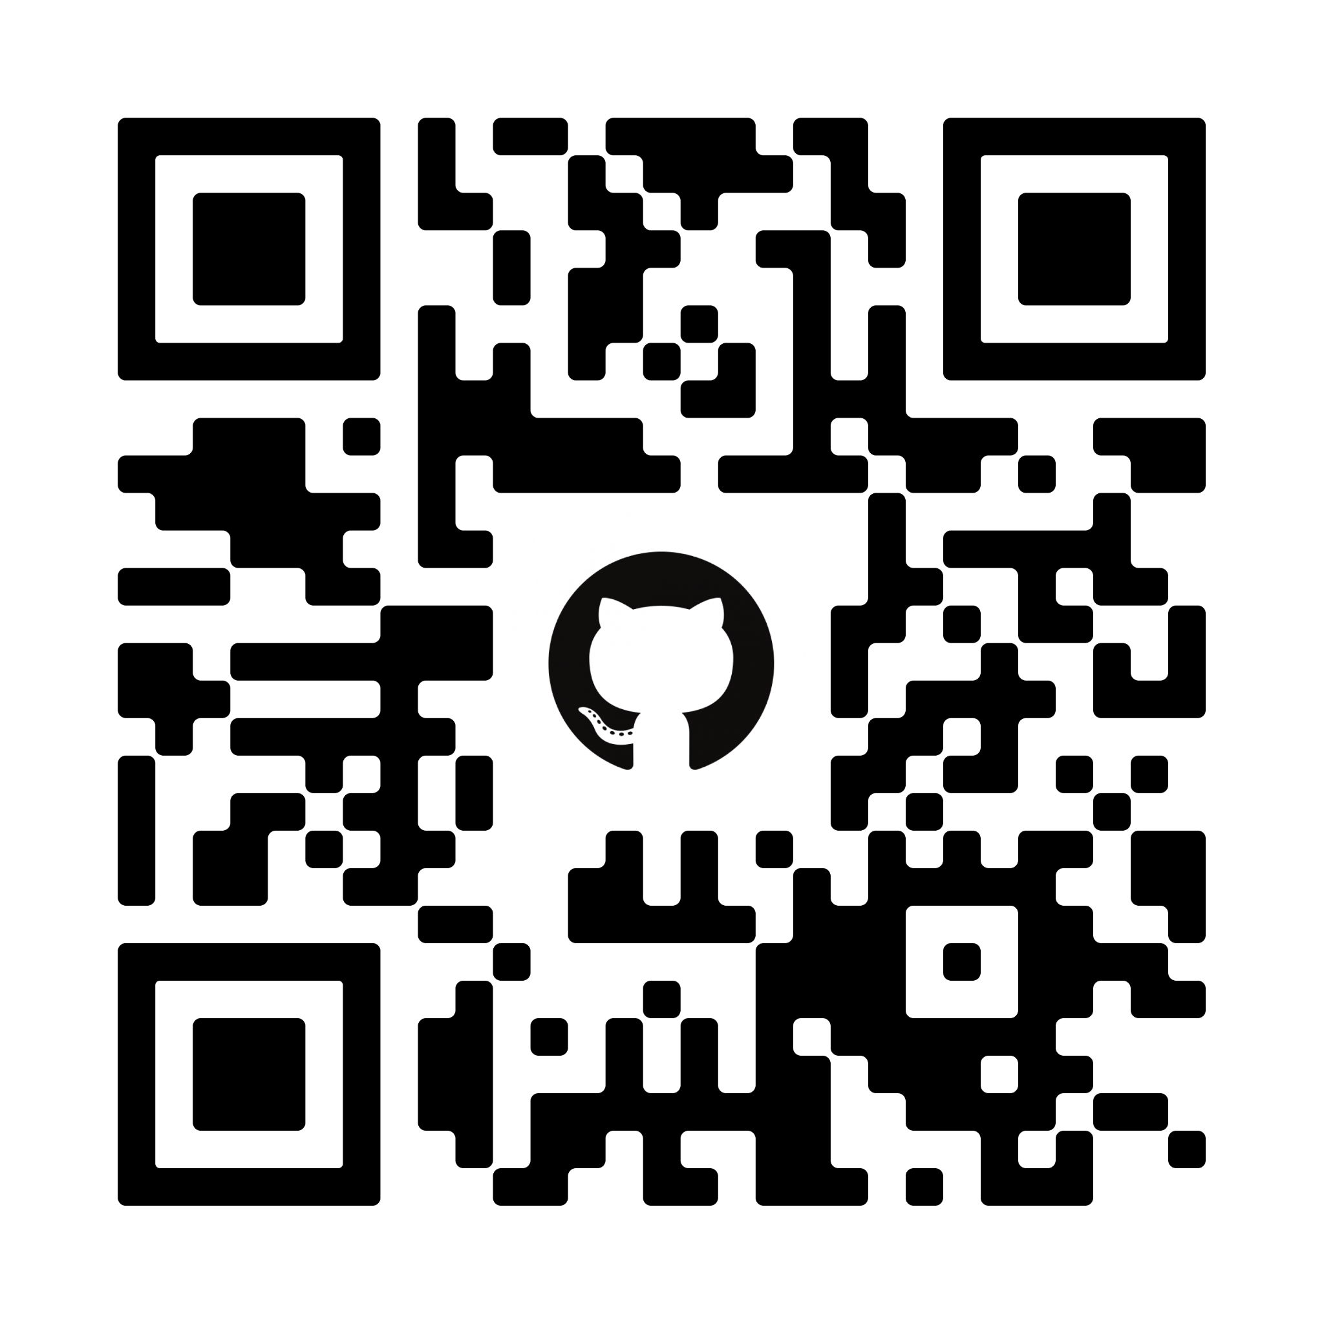
Hacking time
https://github.com/gagan3012/MLH

Slide 21
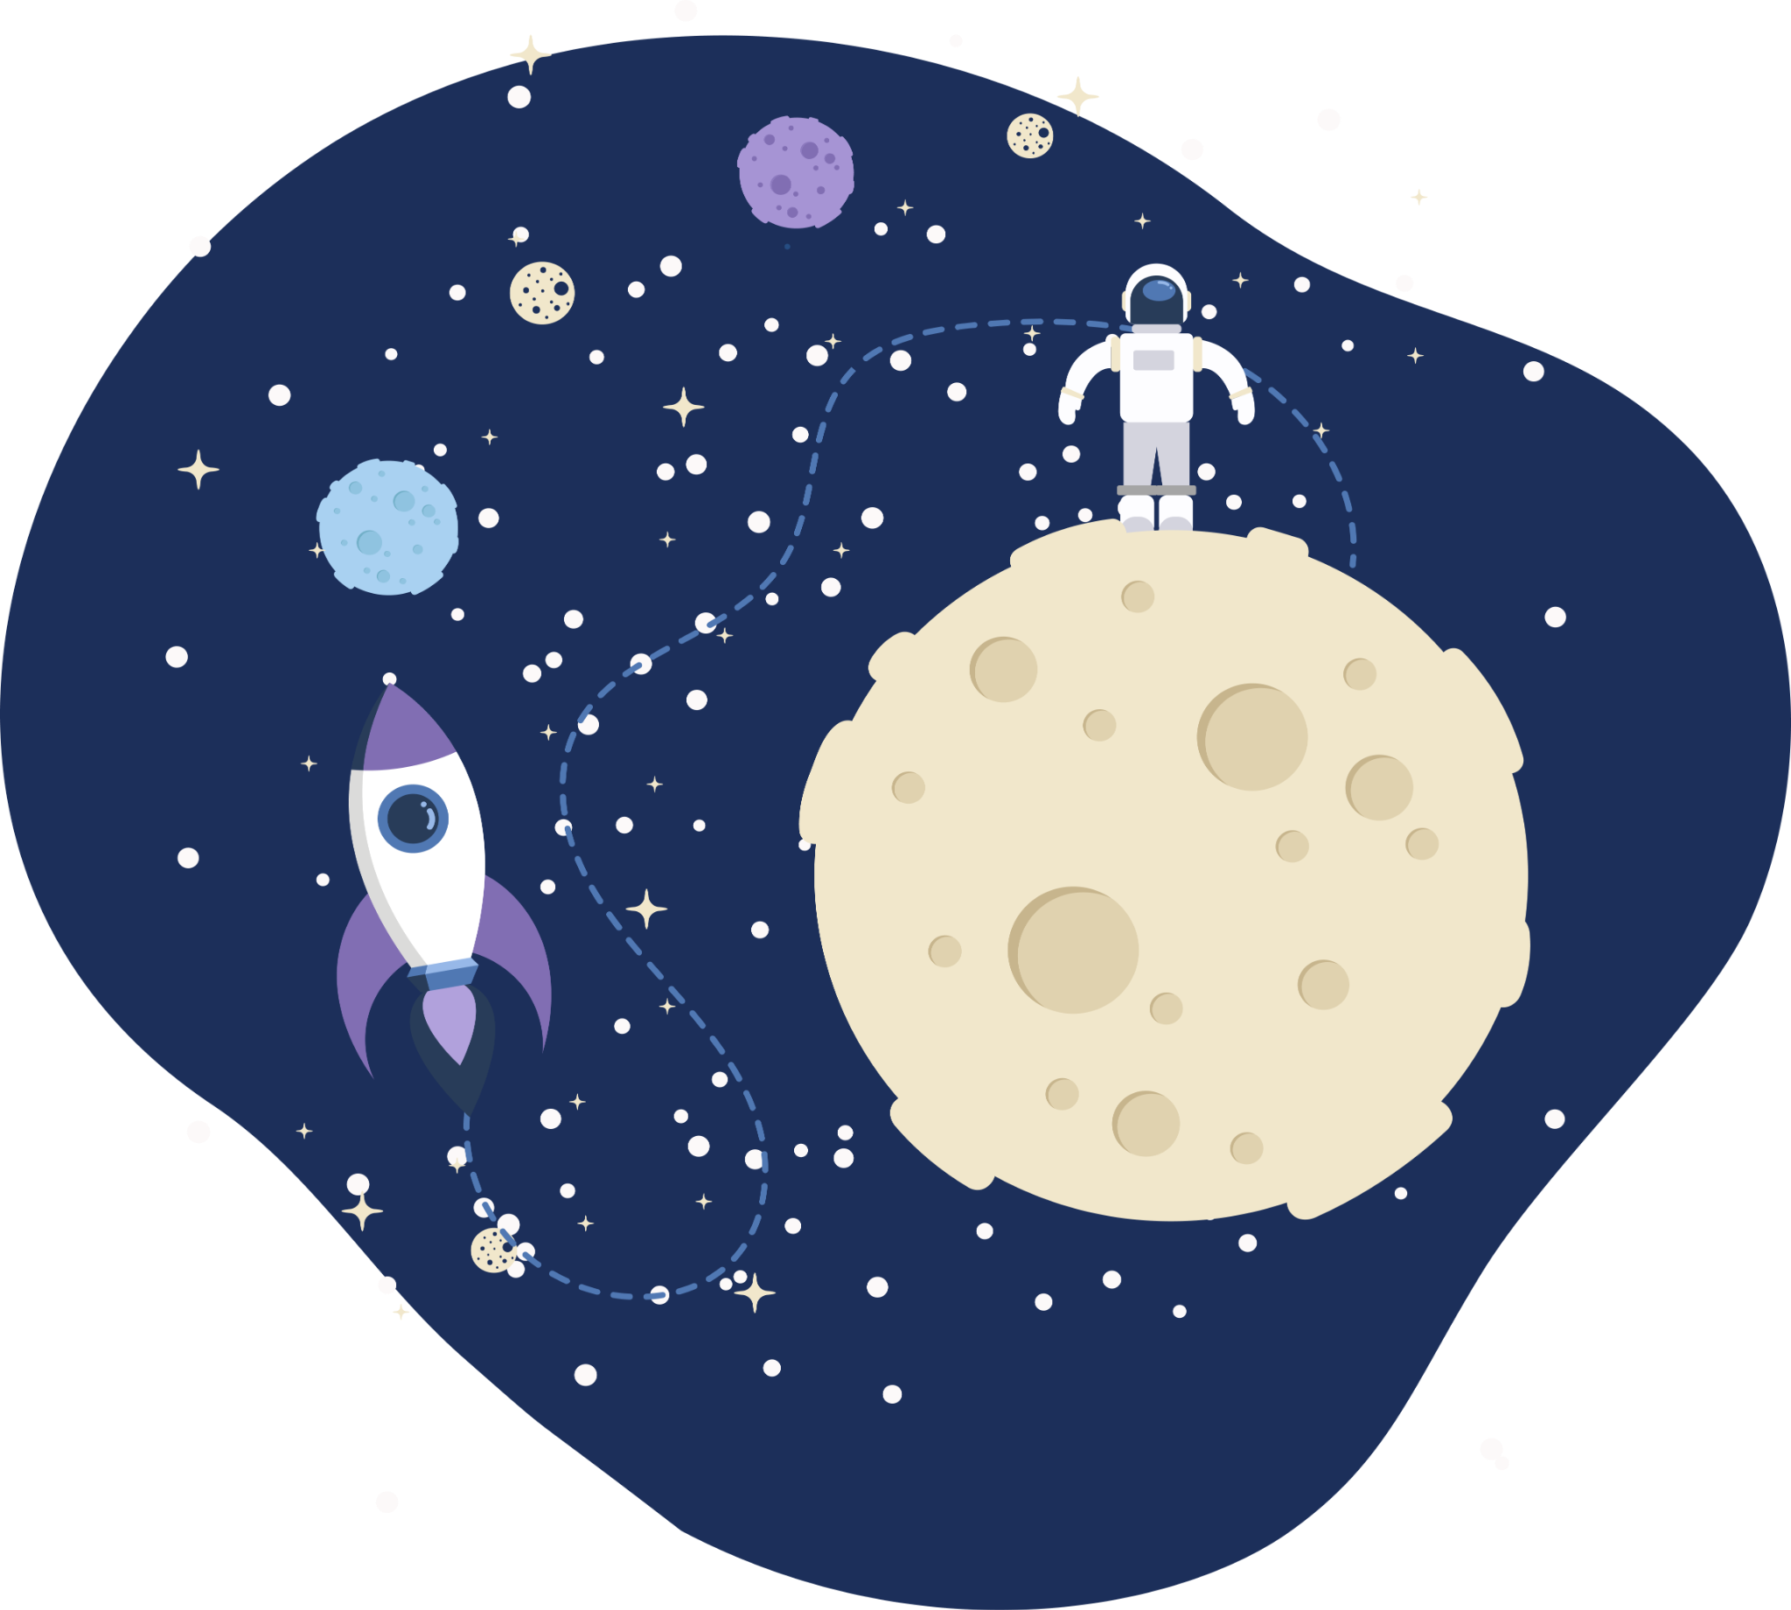
Thank you!
Any questions?

